Slide 1
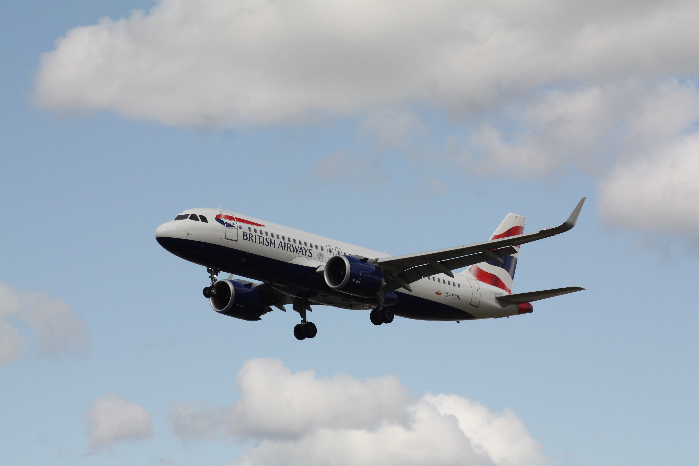
Analysis of British Airways Customer Reviews
A Case Study of 3,531 Customer Reviews from Skytrax website
Created By: Tola Abrahams
tom4tech8@gmail.com

Slide 2
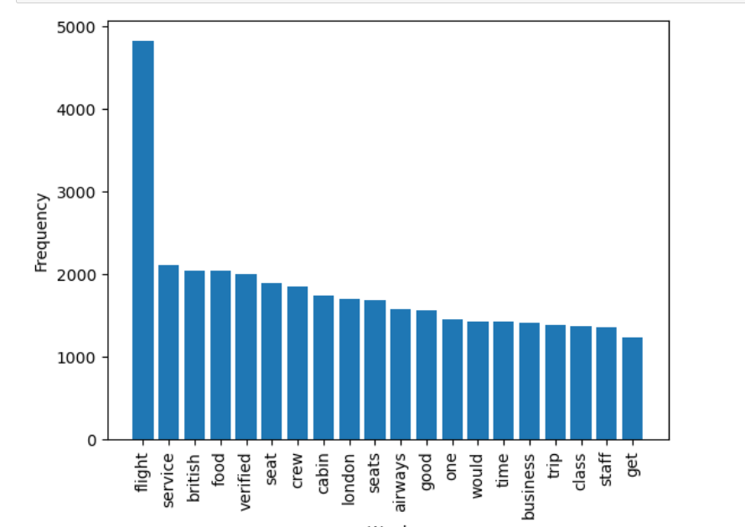
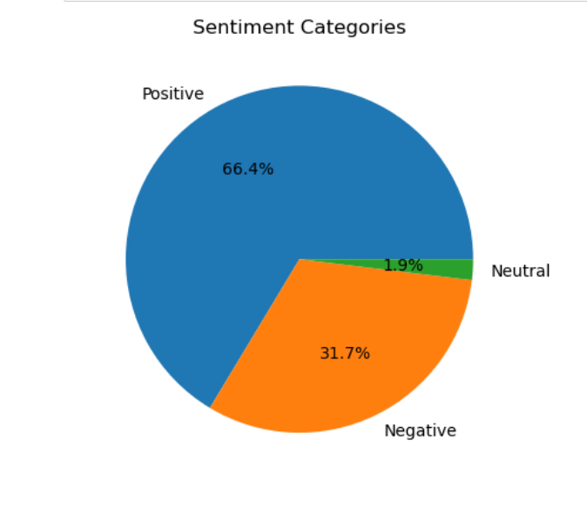
Methodology: Topic modelling, Word cloud, Sentiment Analysis Results: Top 10 Words: Flight, Service, British, Food, Verified, Seat, Crew, Cabin, London, Seats. Top 10 Topics: Flight, Service, Food, Seat, Crew, Cabin, Time, Business Class, Trip, Staff. Sentiment Category: 2344 Reviews are Positive with 66.4%, 1119 Reviews are Negative with 31.7% while 68 are Neutral with 1.9%.
Bar Plot showing Top 20 words in Reviews
Pie Chart showing Sentiment Category
Full details and codes can be found here: https://github.com/MoAbbazi

